Slide 1
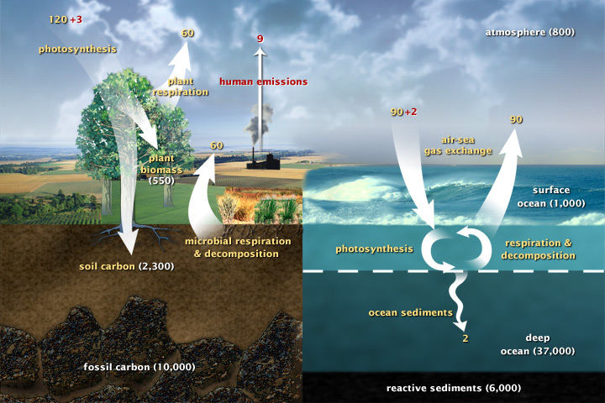
Carbon fluxes in Earth’s climate system (2003)

Slide 2
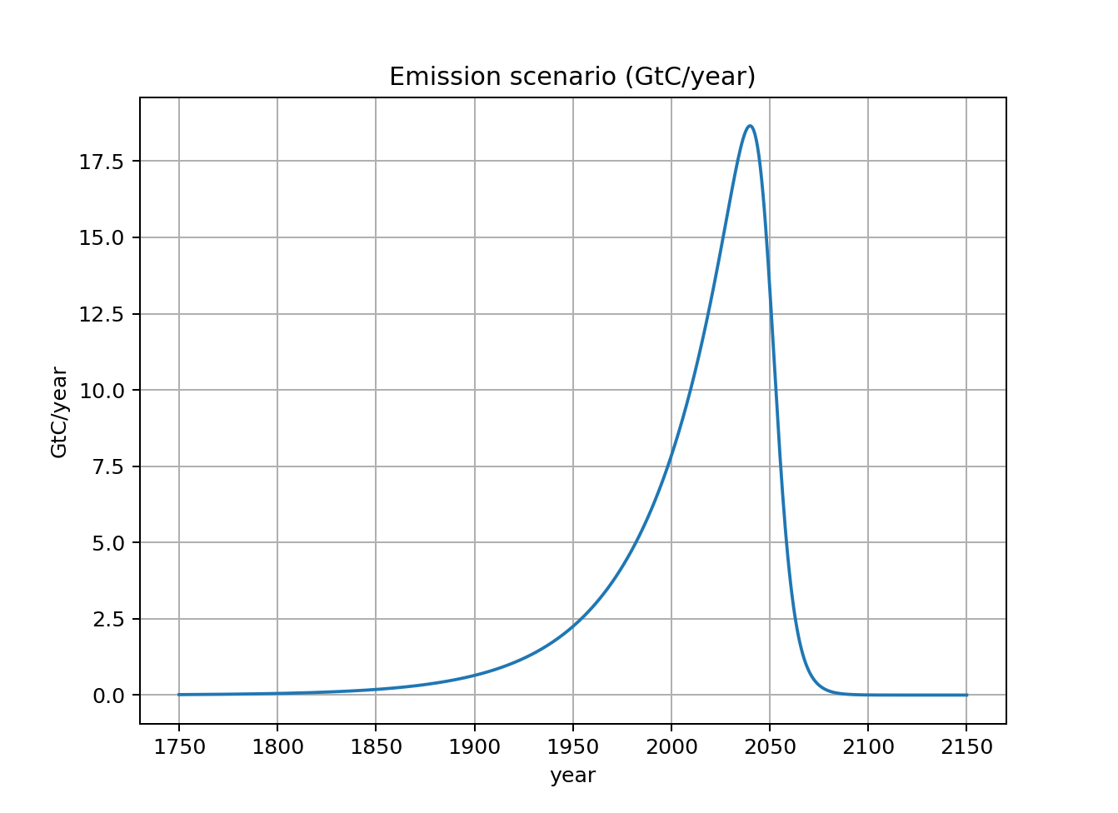
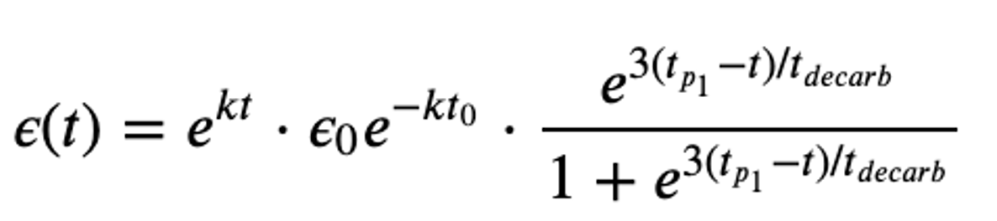
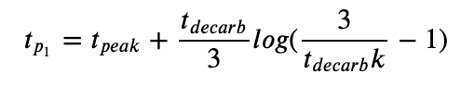
We’re going to need a way to create “emissions scenarios” (like those that informed RCPs, etc.)

Slide 3
We’re going to need a way to create “emissions scenarios” (like those that informed RCPs, etc.)
This is the exponential growth part

Slide 4

We’re going to need a way to create “emissions scenarios” (like those that informed RCPs, etc.)
This is the “pegging” term
Example: $t_{o}=2000$, $ε_{o}=7.6\frac{GtC}{yr}$

Slide 5


We’re going to need a way to create “emissions scenarios” (like those that informed RCPs, etc.)
This term specifies the year of maximum emission and a decarbonization time according to the “80/20” rule
$$t_{peak}=2040$$
$$t_{decarb}=15 years$$

Slide 6
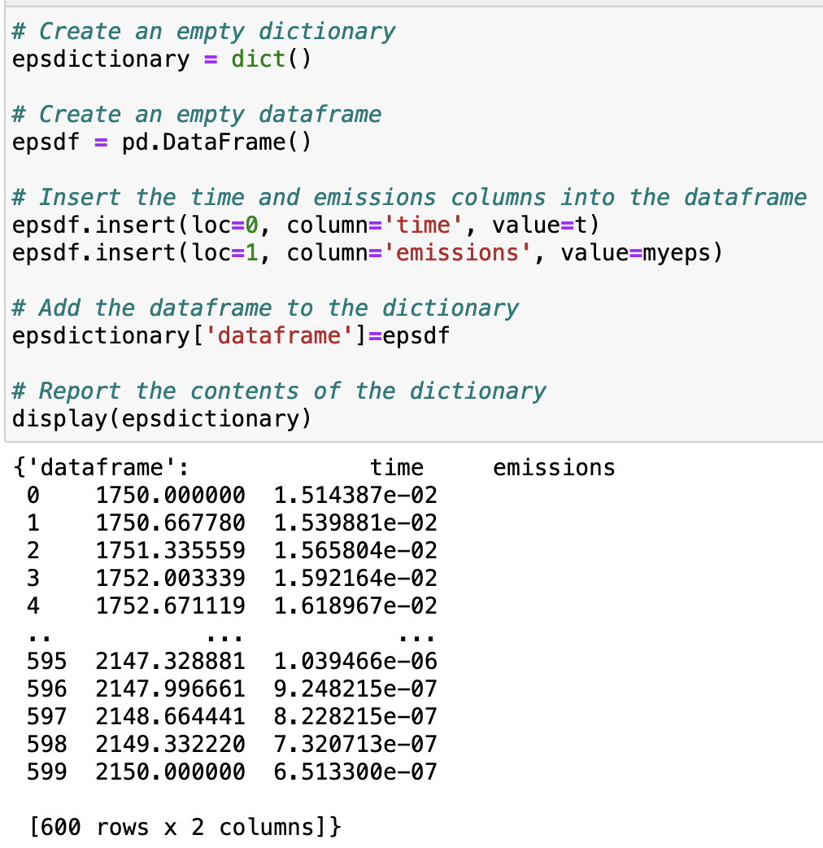
Metadata
Part of good coding practice is finding ways to save data in a way that is "self-documenting." Like, including the units of your data, or other parameters.
Fortunately, with a combination of Python's Pandas package, and a built-in Python feature called dictionaries, we can do all that.

Slide 7
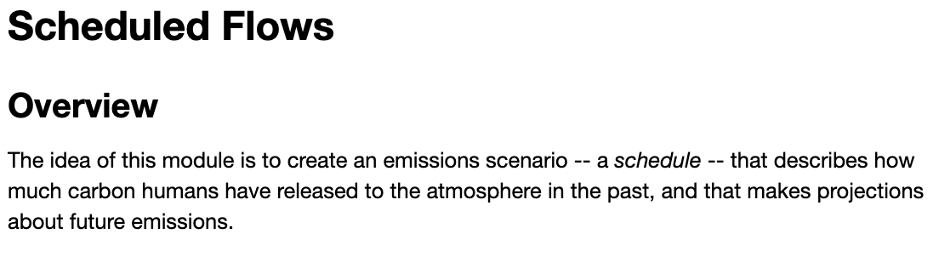
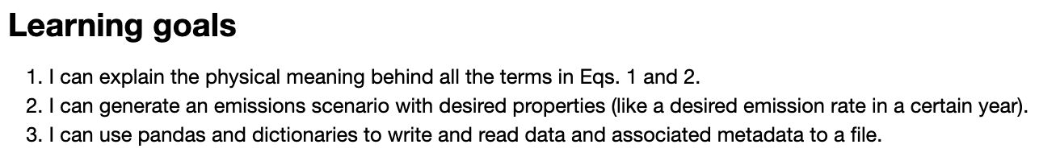
OK, let’s get started!
Notes:
Predict the temperature if CO2 continues to rise. If we reduce CO2 emissions to zero.

